Slide 1


Identifying Ride Service Hotspots in NYC
Big Data Analytics Symposium - Summer 2018
Prince Abunku, Gaurav Bhardwaj, Isha Chaturvedi

Slide 2
Problem Statement
55% of the world’s population lives in urban areas
Expected to increase to 68% by 2050
Subway systems inefficient and unreliable
Need of the hour for alternative options - Uber, Lyft & Via
Need a mode of commute that is less painful and exhausting

Slide 3
Project Objective
Spatial analysis of Taxi/Uber Hotspots

Slide 4
Data Sources
NYC Taxi & Limousine Commission (TLC) Data Trip Record Data (2014) (~6GB)
Uber trip data from a freedom of information request to NYC's Taxi & Limousine Commission (2014) (~4GB)
NYC Open Data shapefiles (~1.5 MB)

Slide 5
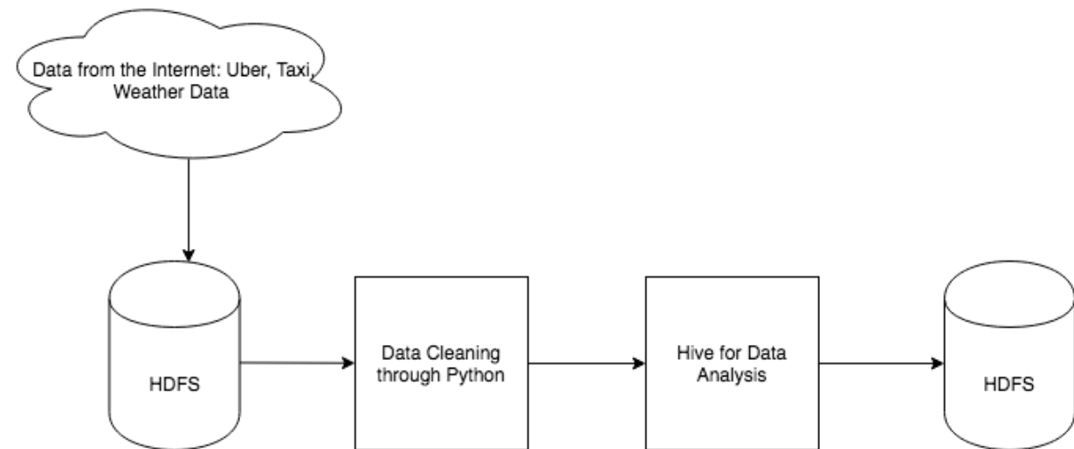
Workflow Design

Slide 6
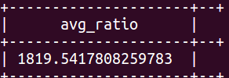

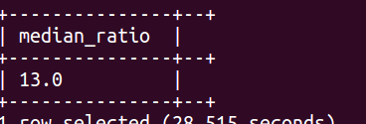
Pre-processing & Analysis
MapReduce - Removed irrelevant columns, NaNs, outliers
Converted Shapefiles to GeoJson, Read GeoJson in Hive
Ran analytic Queries in Hive
Maps in GeoPandas

Slide 7
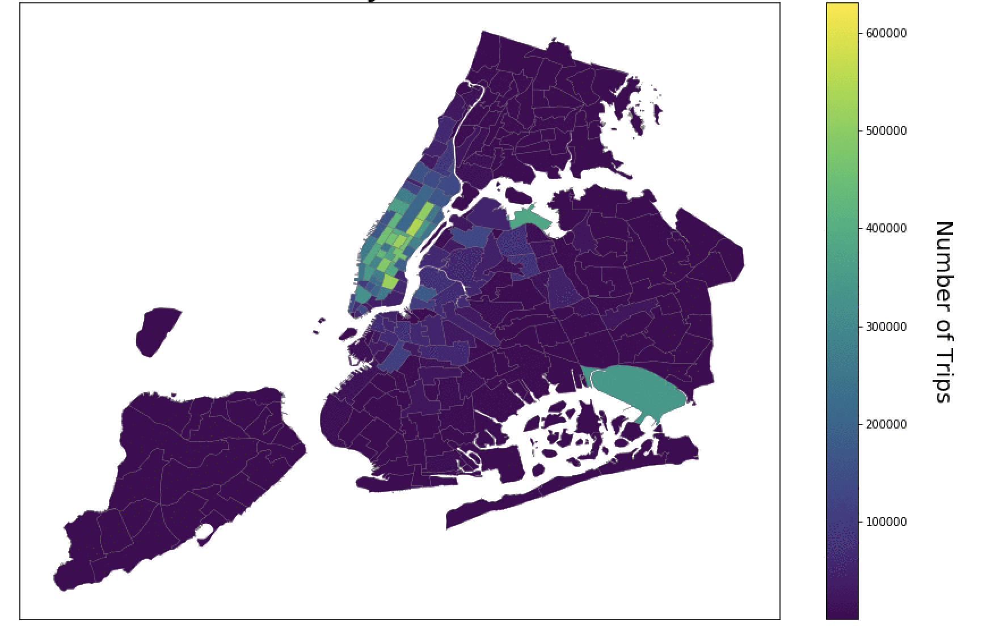
Results - Yellow Taxi Hot Spots

Slide 8
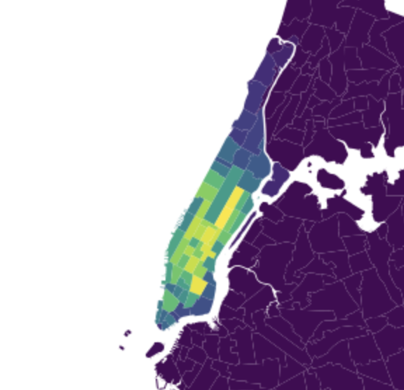
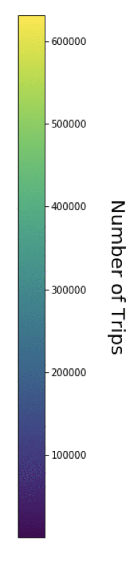
Results - Yellow Taxi Hot Spots (Manhattan)

Slide 9
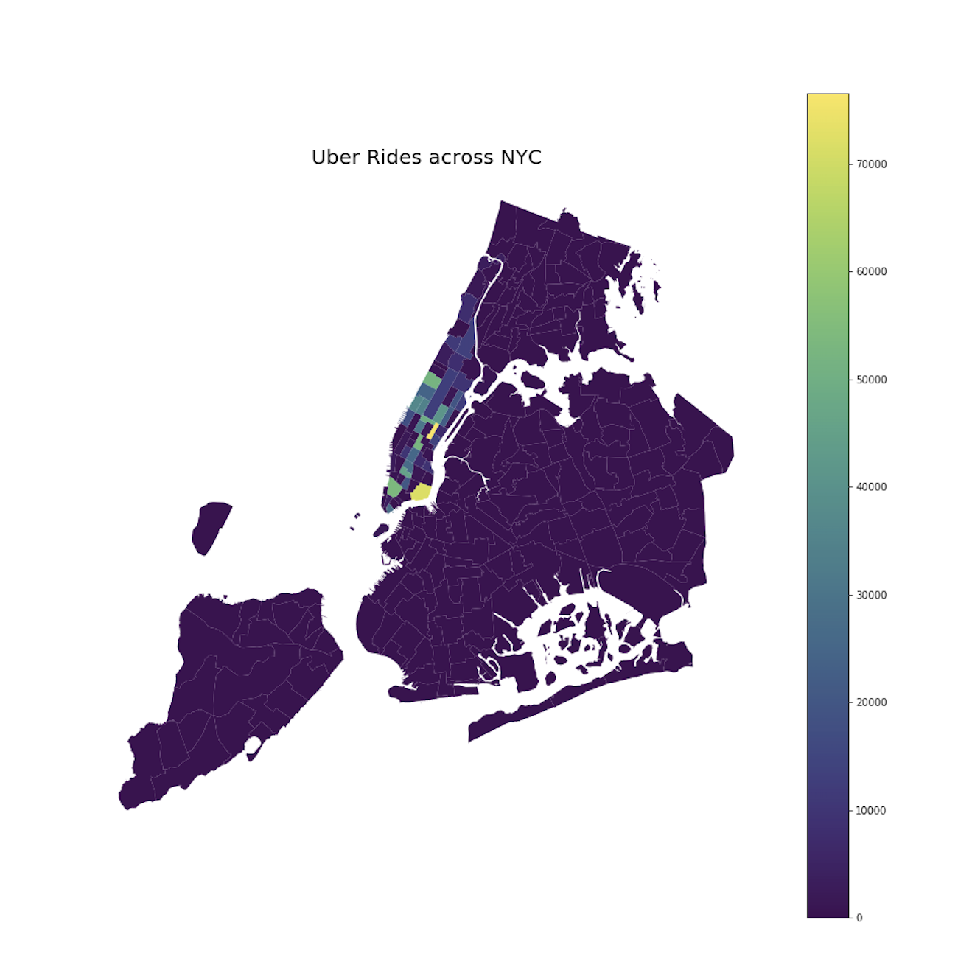
Results - Uber Hot Spots (Manhattan)

Slide 10
Solution: RideShare Services
Pros:
Economical
Low Carbon Foot-Print
Lower Traffic
Cons:
Uber & Lyft not regulated in some cities
Time Inefficiency

Slide 11
Thank you!

